Slide 1


Slide 2


Slide 3
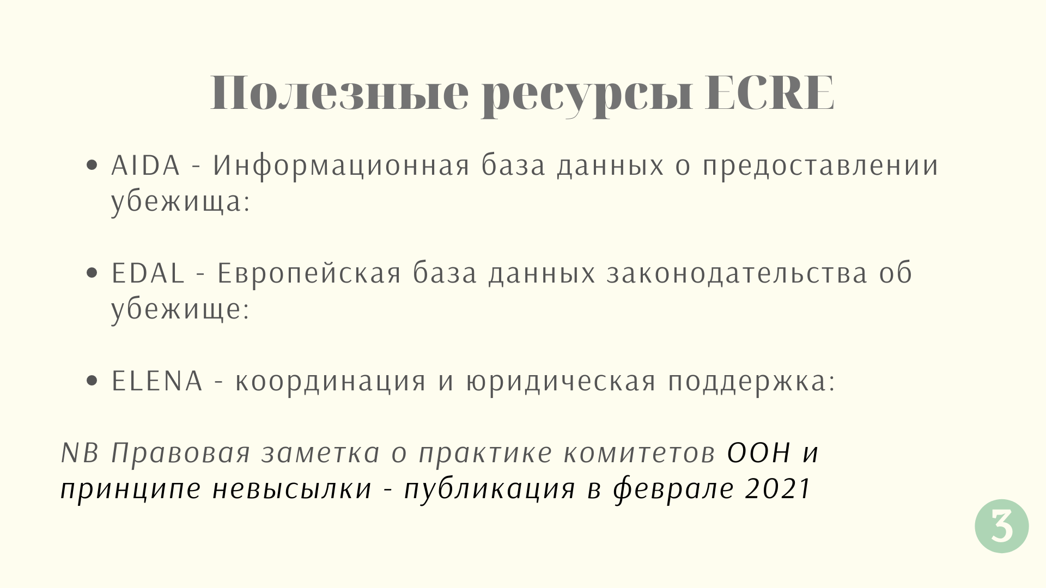
asylumineurope.org
https://www.asylumlawdatabase.eu/en
https://www.ecre.org/need-a-lawyer/

Slide 4


Slide 5


Slide 6


Slide 7
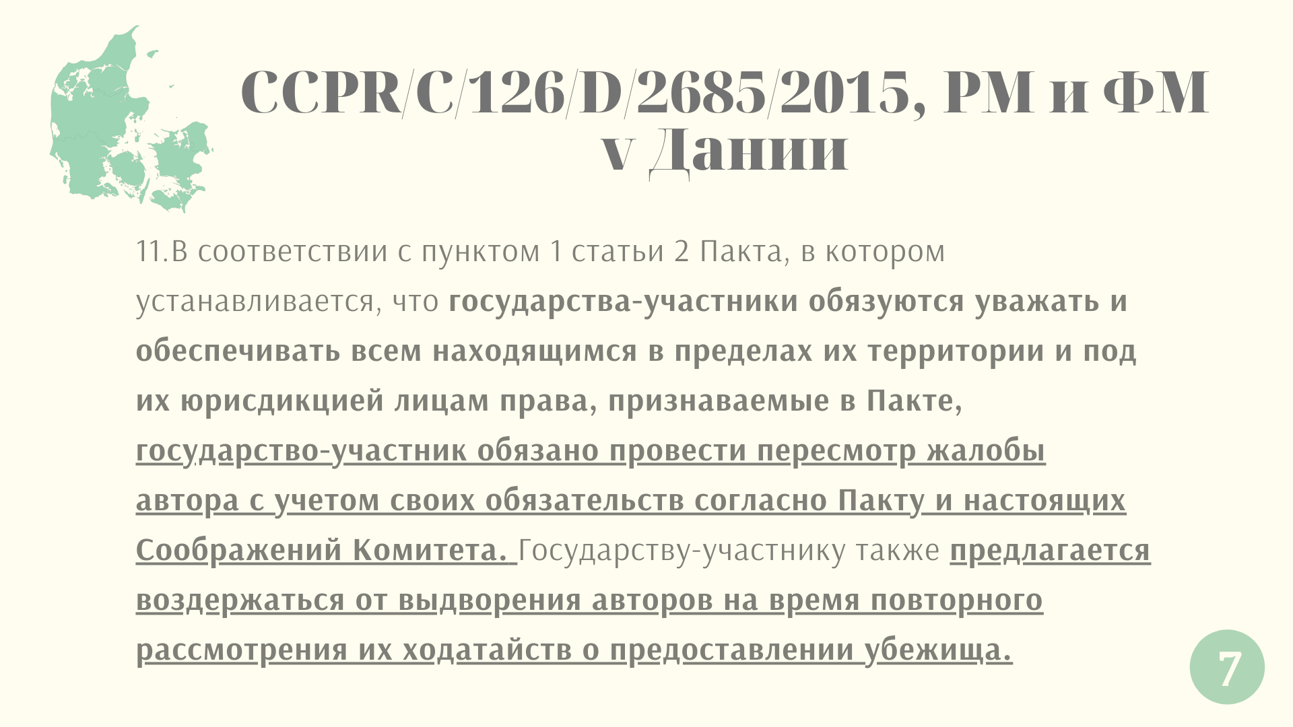

Slide 8
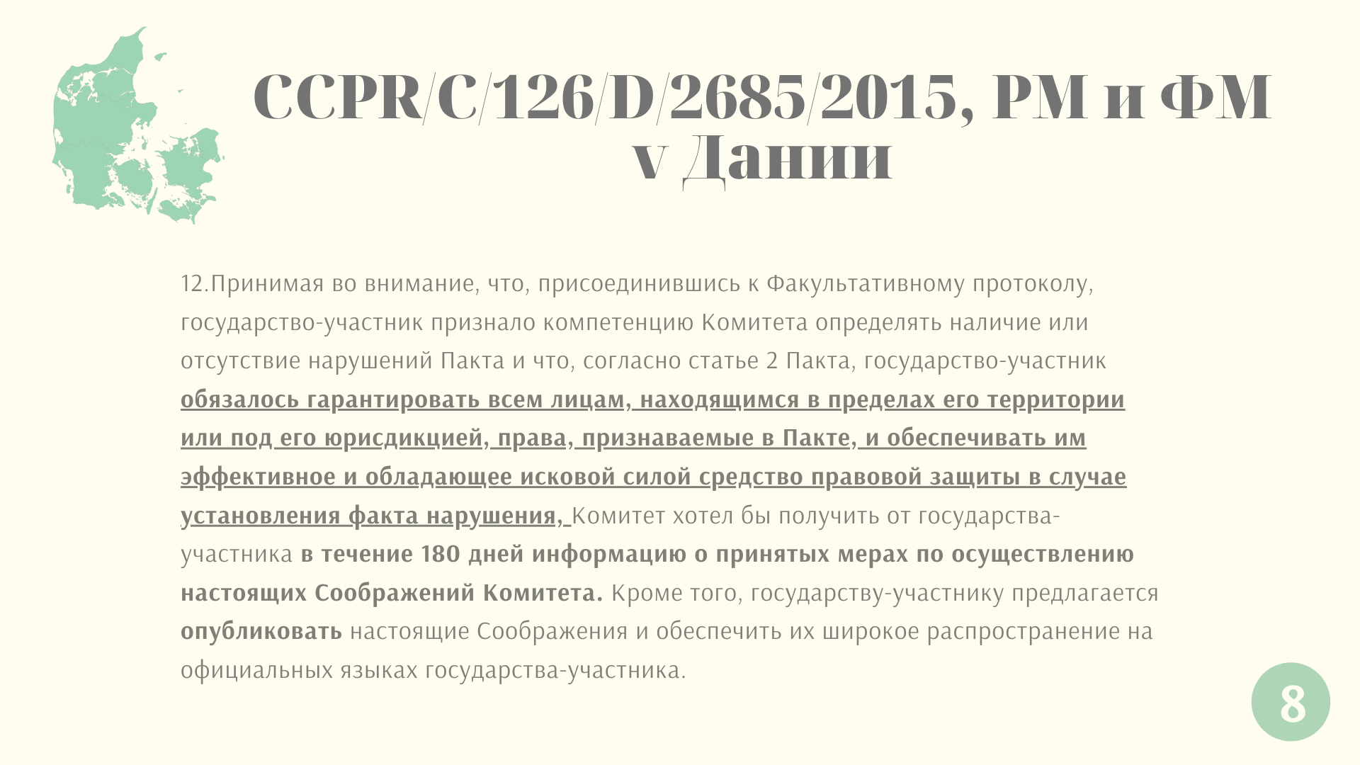

Slide 9
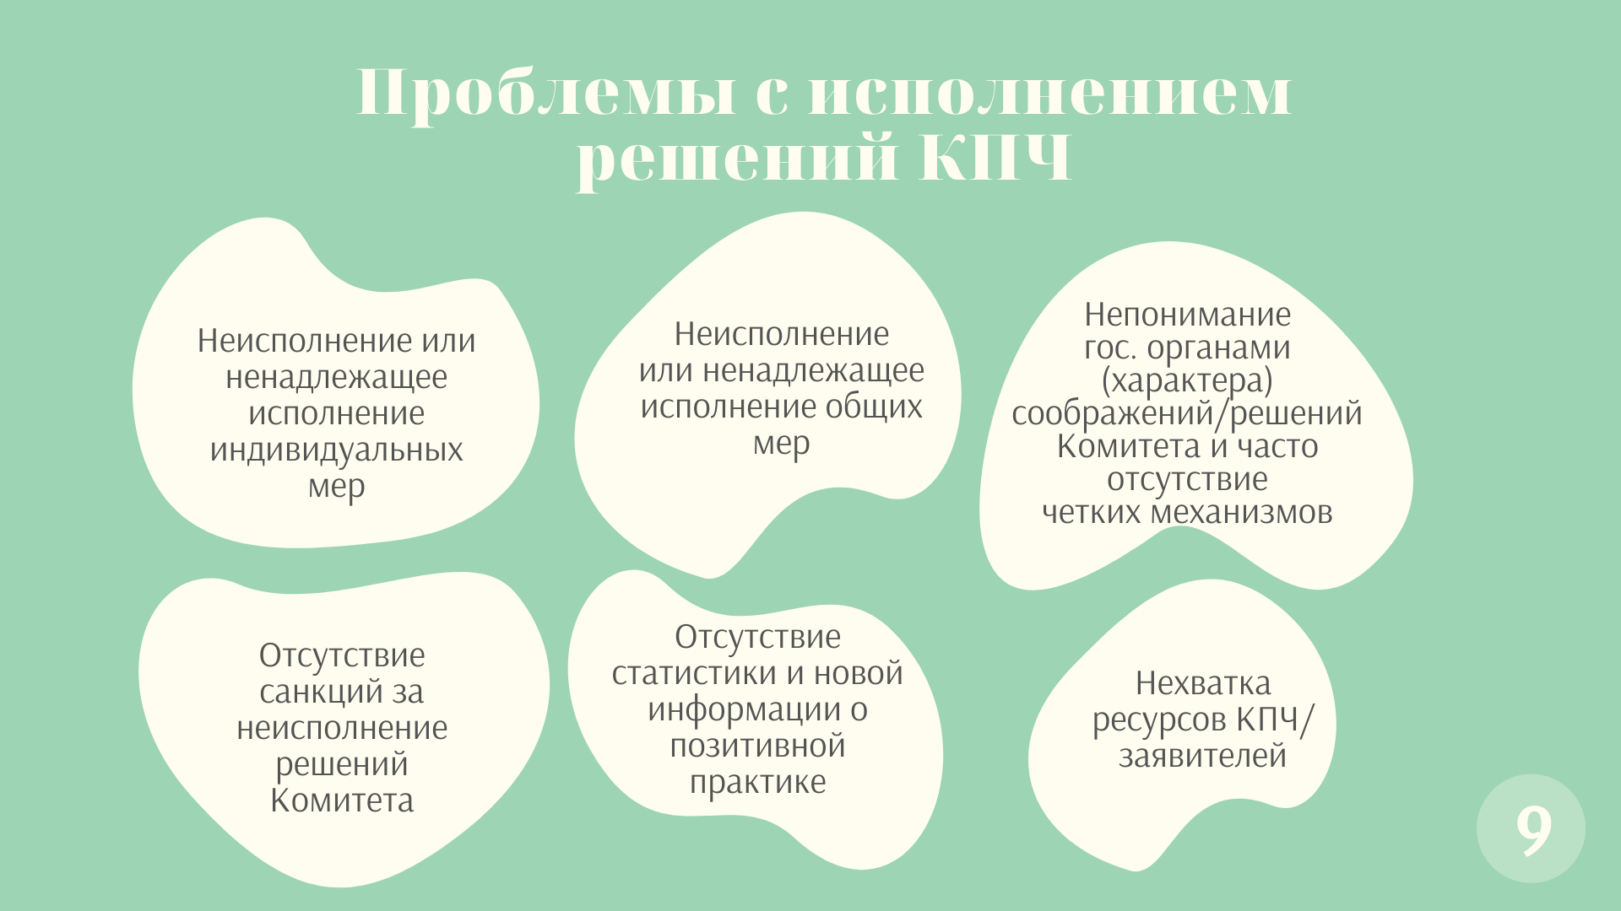

Slide 10


Slide 11
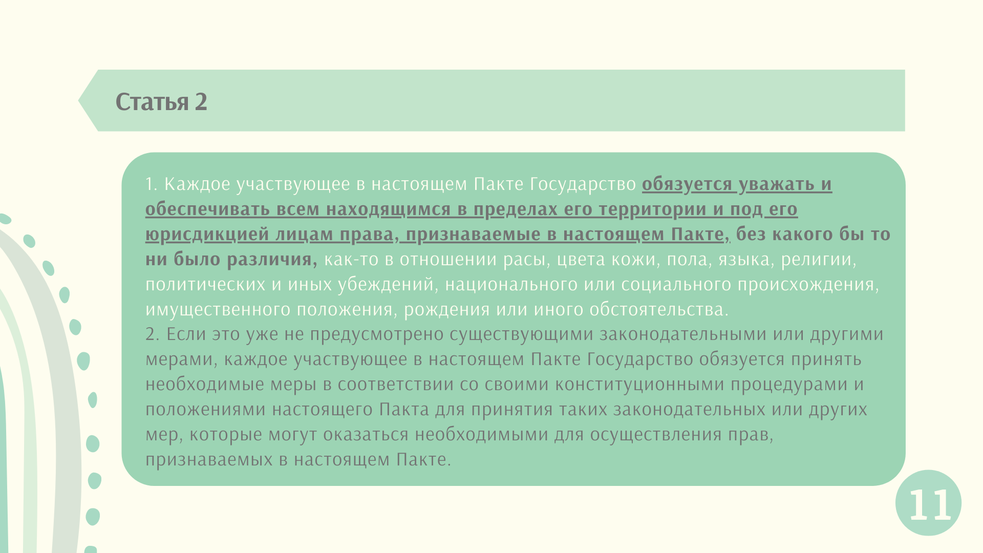

Slide 12
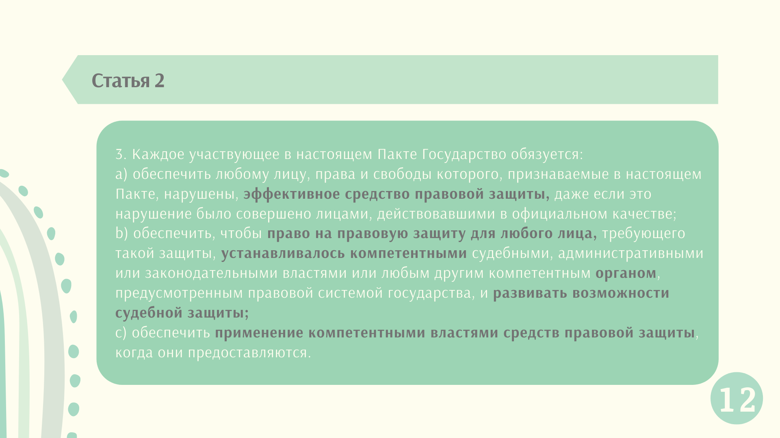

Slide 13
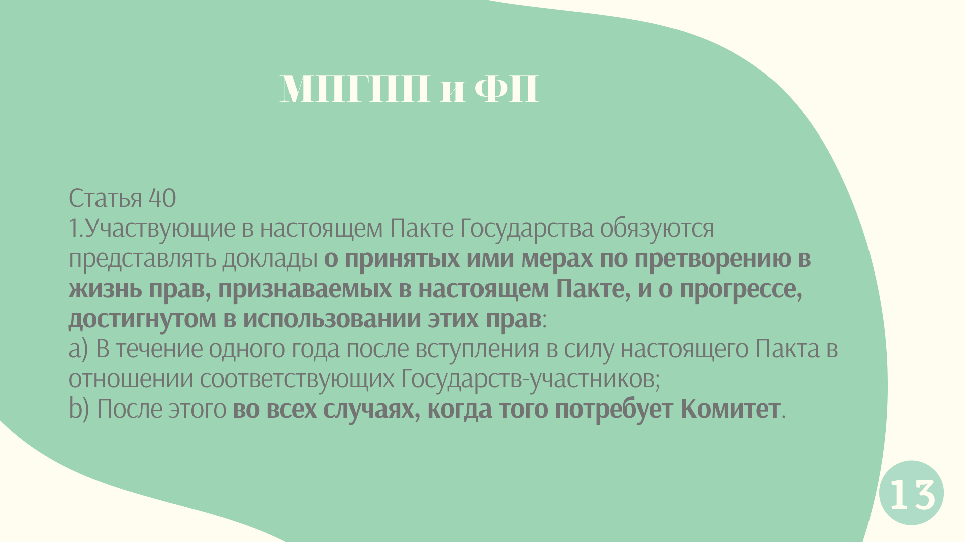

Slide 14
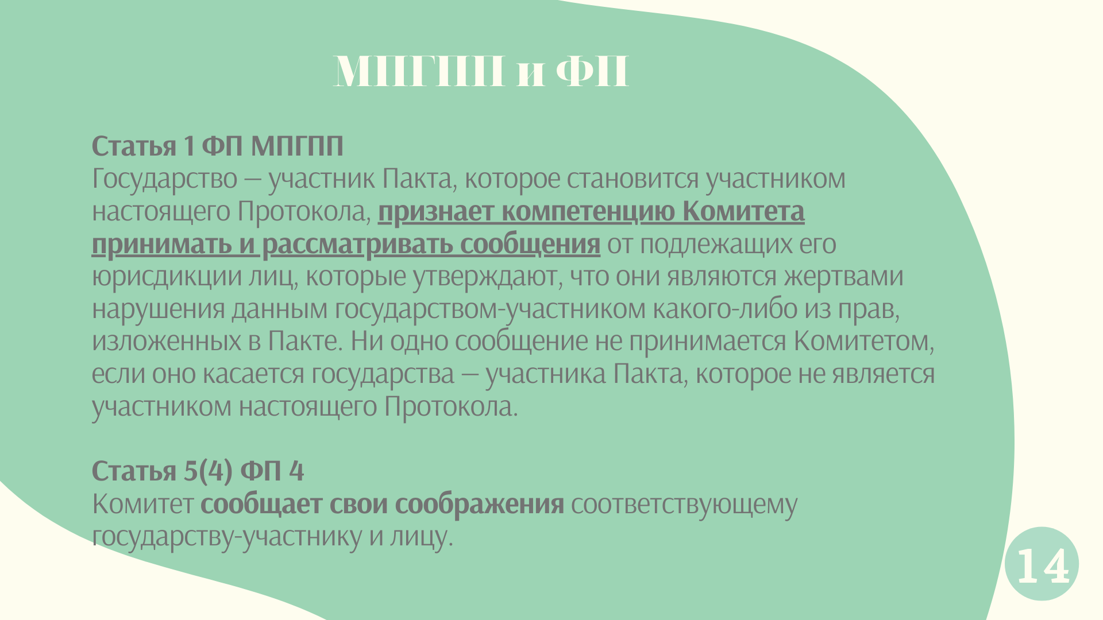

Slide 15
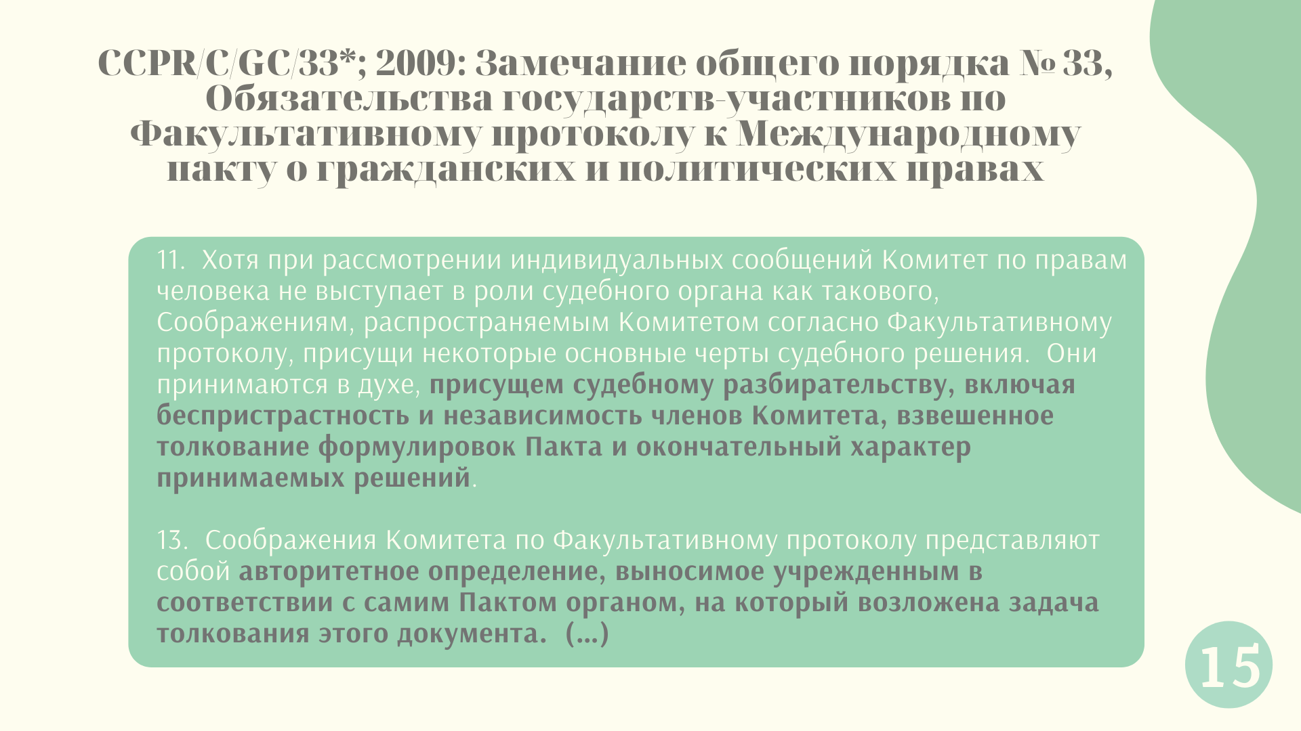

Slide 16
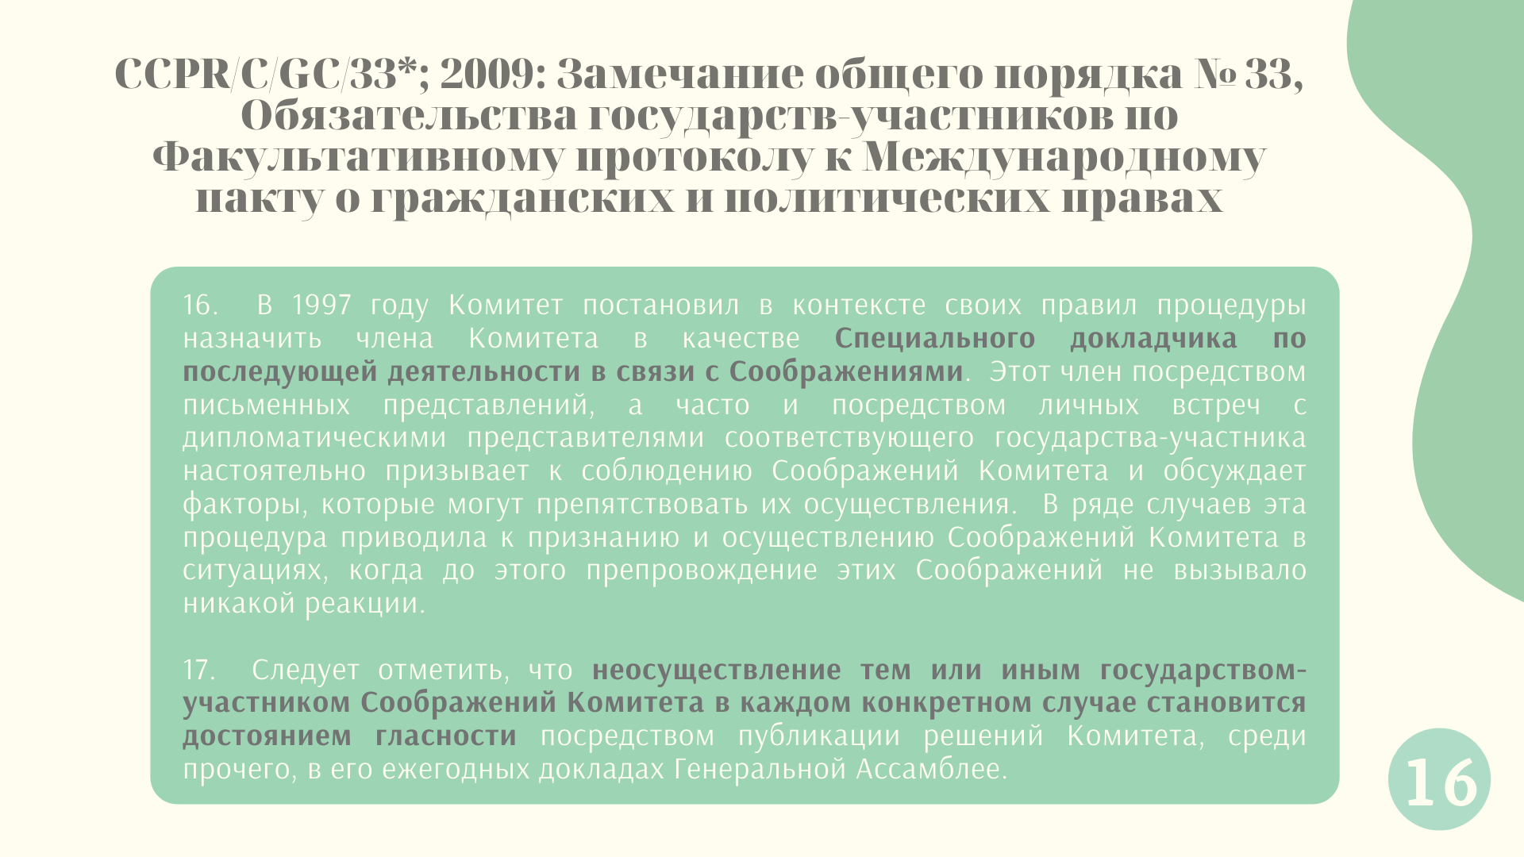

Slide 17
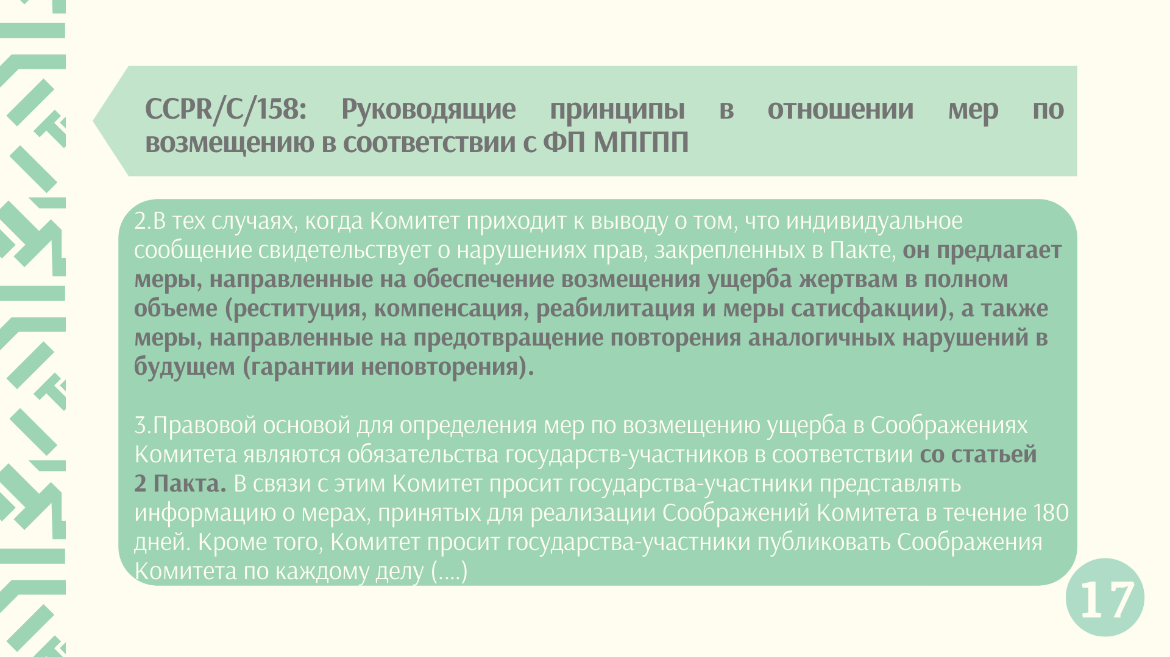

Slide 18
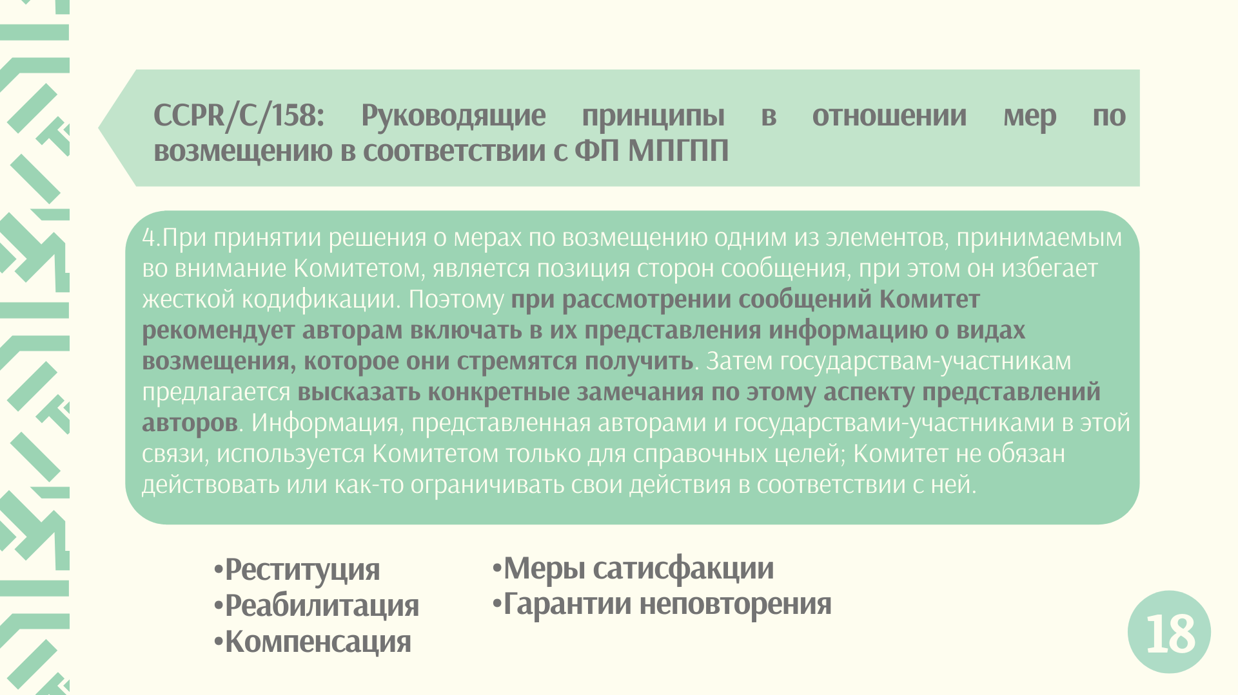

Slide 19

https://bit.ly/2Un0fro

Slide 20

(https://bit.ly/3luTPCI)

Slide 21


Slide 22
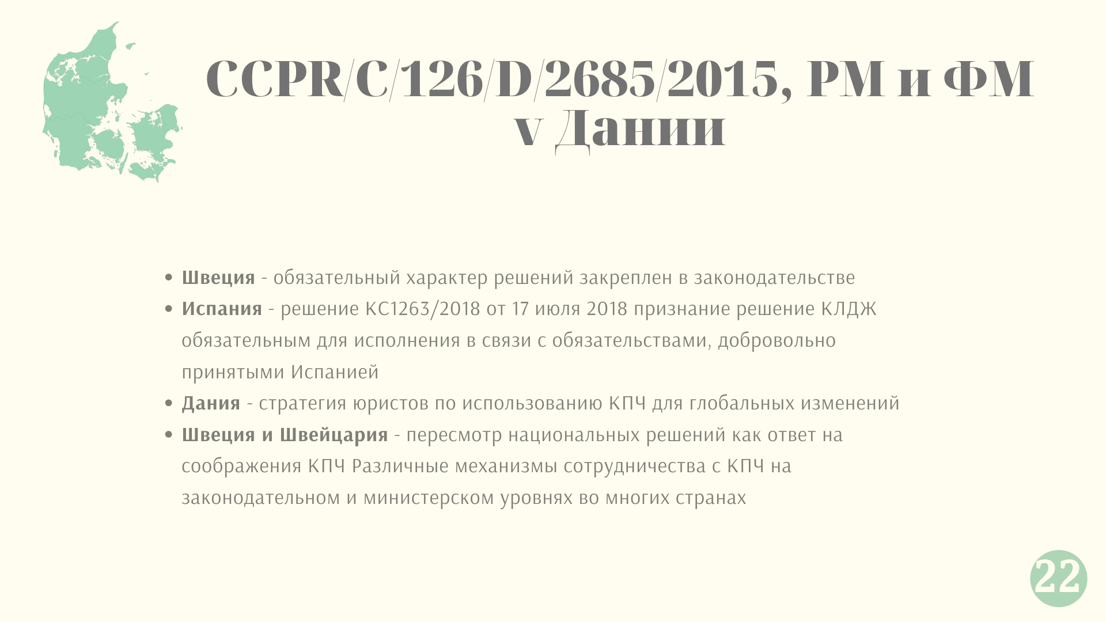

Slide 23


